Slide 1
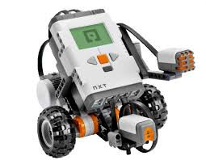
Welcome to Robotics

Slide 2
Topics
Class syllabus
Introduction to Robots
Start building the robot

Slide 3
Course Syllabus
Tzipora Halevi, Assistant Professor email: halevi@sci.brooklyn.cuny.edu Office Hours: Mondays, 2:30pm – 5:30pm Ingersol room 2156A
Course has 6 units. Each unit includes:
1-2 Lecures
1-2 labs
1-2 assignments
Class presentation

Slide 4
Course Syllabus (Cont.)
Attendance: This is a hands-on course. There is no option of making up missed labs.
Lab with two partners per group
Hands-on session using Lego Robot (Mindstorm NXT).
Books:
Autonomous Robots: From biological inspiration to implementation and control, by George Bekey, MIT Press, 2005 (recommended)
The Robotics Primer, Mataric, 2007

Slide 5
Course Syllabus(cont.)
Assignments include:
Written, take home
Quizzes, tests
In-class presentation
Demonstrations, slide-show, etc.
Grading = 6 unit material (10% each) + Exam (30%) + Attendance+Participation (10%)

Slide 6
Unit A - Introduction to Robots
Why study robotics?
What is a robot?
Robots in society
Robot components
Introduction to the course robots

Slide 7
Unit A - Introduction to Robots
Reading:
Autonomous Robots: From biological inspiration to implementation and control, by George Bekey, MIT Press, 2005; chapter 1.
The Robotics Primer, chapters 1–3 (pages 1–28)
Big Dog the rough-terrain quadruped robot, Raibert at. Al
Legged robots by Raibert

Slide 8
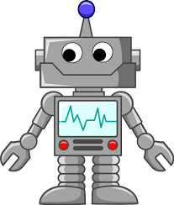
Why study robotics?
https://edspace.american.edu/perf683/2015/10/02/how-easy-would-it-be-for-a-robot-to-takeover-your-job/
Introduction to computational aspects of robotics
Interdisciplinary - related to other disciplines
Artificial Intelligence, Computer Vision, Control Systems, Neuroscience, Biology
Instant feedback
Robots moves, makes noises, etc.
Developing field
Robots will change the world we live in
Potential future career path...

Slide 9
What is a robot?
“A robot (also called a droid) is a machine —especially one programmable by a computer— capable of carrying out a complex series of actions automatically.” – Wikipedia
Robots can be autonomous or semi-autonomous
can refer to both physical robots and virtual software agents
We focus on “AUTONOMOUS” mobile robots. These robots can be considered “agents” in the physical world…

Slide 10
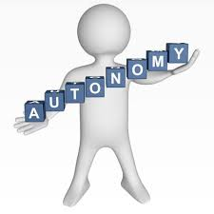
Autonomy
http://www.referenceforbusiness.com/management/A-Bud/Autonomy.html
What is an autonomy (autonomous)?
Derived from ancient greek:
Auto = self, nomos = “law”
"one who gives oneself one's own law"
Be independent, free of constraints
Able to act on ones own initiative
For robots ==?
No REMOTE CONTROL!

Slide 11

Agents
https://www.coveredca.com/agents/
What is an agent?
Derived from the latin word “AGERE” (todo).
Acts on behalf of some other entity to achieve goal.
Depends on the context: Real estate agent, chemical agent, etc.
Autonomous Agent: An agent that works on behalf of someone else, but can make decisions on its own, guided by feedback (for example, from its sensors).

Slide 12
What is a robot? (Cont.)
Our definition of robot (for our purposes):
An autonomous agent, acting independently. Our environment is the real world.
The robot can sense its environment (including its own internal state) and act on it to achieve pre-defined goals.
Robotics: The study of robots – their design, construction, capabilities and purpose.

Slide 13
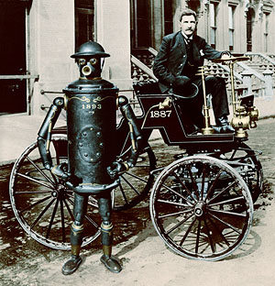
Robots History
From the Slavic word robota (“forced laborer”)
First applied as a term for artificial automata in a 1920 play
R.U.R. (Rossum’s Universal Robots) , by the Czech writer, Karel Čapek
Self-operating machines date back to the ancient China, Greece and Ptolemaic Egypt.
Resembling humans and animals
http://timetunnel.bigredhair.com/robots/index.html
Notes:
Picture is of BoilerPlate, a fictional robot created in 2000, which would have existed in the victorian era and early 20th century

Slide 14
Robots History
Isaac Asimov, scientist and science fiction author coined the word “Robotics” to describe the field of study.
Asimov proposed in "Runaround" (1942) the 3 Laws of Robotics:
A robot may not injure a human being or, through inaction, allow a human being to come to harm.
A robot must obey any orders given to it by human beings, except where such orders would conflict with the First Law.
A robot must protect its own existence as long as such protection does not conflict with the First or Second Law.

Slide 15
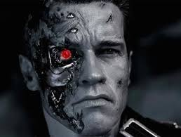
Robots History
Isaac Asimov, scientist and science fiction author coined the word “Robotics” to describe the field of study.
Asimov proposed in "Runaround" (1942) the 3 Laws of Robotics:
A robot may not injure a human being or, through inaction, allow a human being to come to harm.
A robot must obey any orders given to it by human beings, except where such orders would conflict with the First Law.
A robot must protect its own existence as long as such protection does not conflict with the First or Second Law.
Hollywood broke these rules in “The terminator” [1984], “Transformers”[2007] movies

Slide 16
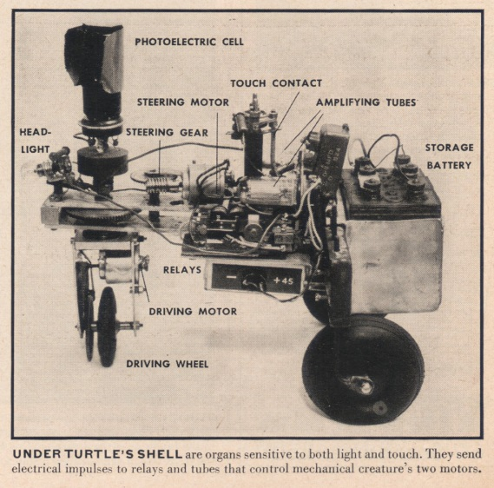
The First Robots
* http://cyberneticzoo.com/cyberneticanimals/elsie-cyberneticanimals/elsie/
Grey Walter's Tortoises (1940):
Simulated biological systems (biomemetic).
Machines with simple sensors that could:
React to light - detect/follow/avoid light.
Track/Move/Avoid obstacles.
Feed (recharge batteries) – robots could find their way to a recharging station when they ran low on battery power
Simple reasoning:
Reactive control using a collection of prioritized “reflexes”.
Could still lead to complex behavior (emergent phenomena).
Notes:
Grey Walter was a British neurophysiologist

Slide 17
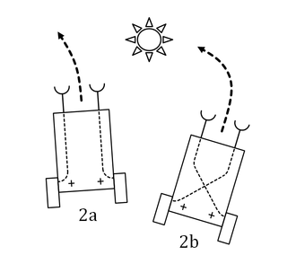
The First Robots (cont.)
*image from https://en.wikipedia.org/wiki/Braitenberg_vehicle
Braitenberg's vehicles (1984):
Not actually built (by him) but proposed.
Started out with a single motor and a single light sensor, and gradually progressed to more motors and more sensors, and more interesting connections between them.
Excitatory and Inhibitory Connections
Stronger signals could induce stronger response.
For example, a light sensor could be connected directly to the wheels, so the stronger the light, the faster the robot moved, or even the inverse of the strength.

Slide 18
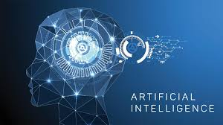
Artificial Intelligence (AI)
The study of "intelligent agents“
“devices that perceive their environment, take actions to maximize their chance of success at some goal” *Wikipedia
Field created in 1956
Minksy, McCarthy, Newell, Simon
Produced “Ground breaking” programs that could:
Play and win checkers, solve word problems, prove logical theorems, speak English.
http://allevi8marketing.com/artificial-intelligence-small-business/
Notes:
From Wikipedia

Slide 19
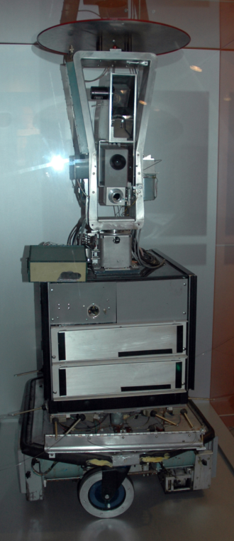
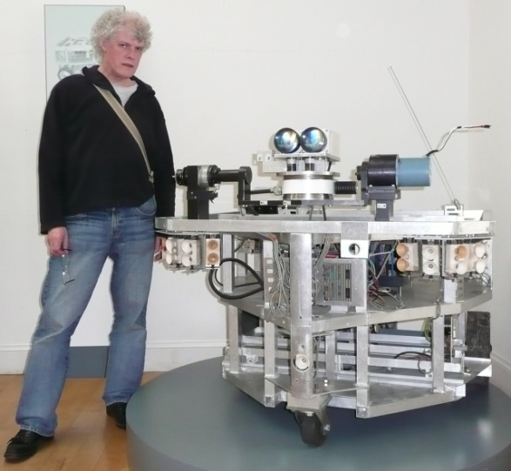
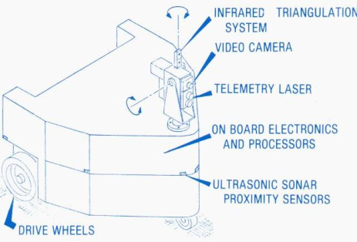
Early AI Inspired Robots
Shakey the robot (66 – 72)
First general-purpose mobile robot to use “reason”
Could analyze commands, break them down into basic chunks by itself.
Used a camera & bumper sensors to create a "model" of it's environment to help it create and execute plans.
HILAIRE(1970's)
Camera, ultrasound sensors, laser rangefinder.

Slide 20
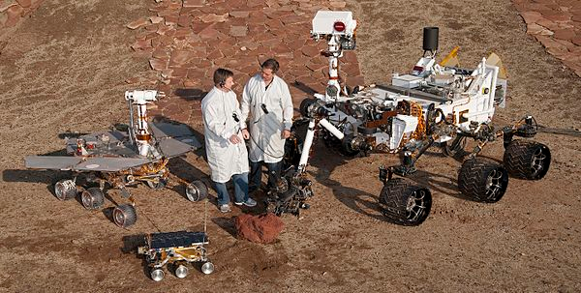
AI Insired Robots (cont.)
Rover (60’s – current):
A space exploration vehicle
Some were fully autonomous
Camera and Ultrasound
* http://cyberneticzoo.com/cyberneticanimals/1977-hilare-autonomous-mobile-robot-french/
** https://en.wikipedia.org/wiki/Rover_(space_exploration)

Slide 21
Robots Today and in the Future
If a job is repetitive, and only requires basic direction following and decision making skills, a robot can AND will wind up doing it.
Corporations are profit driven.
Machines will replace humans

Slide 22
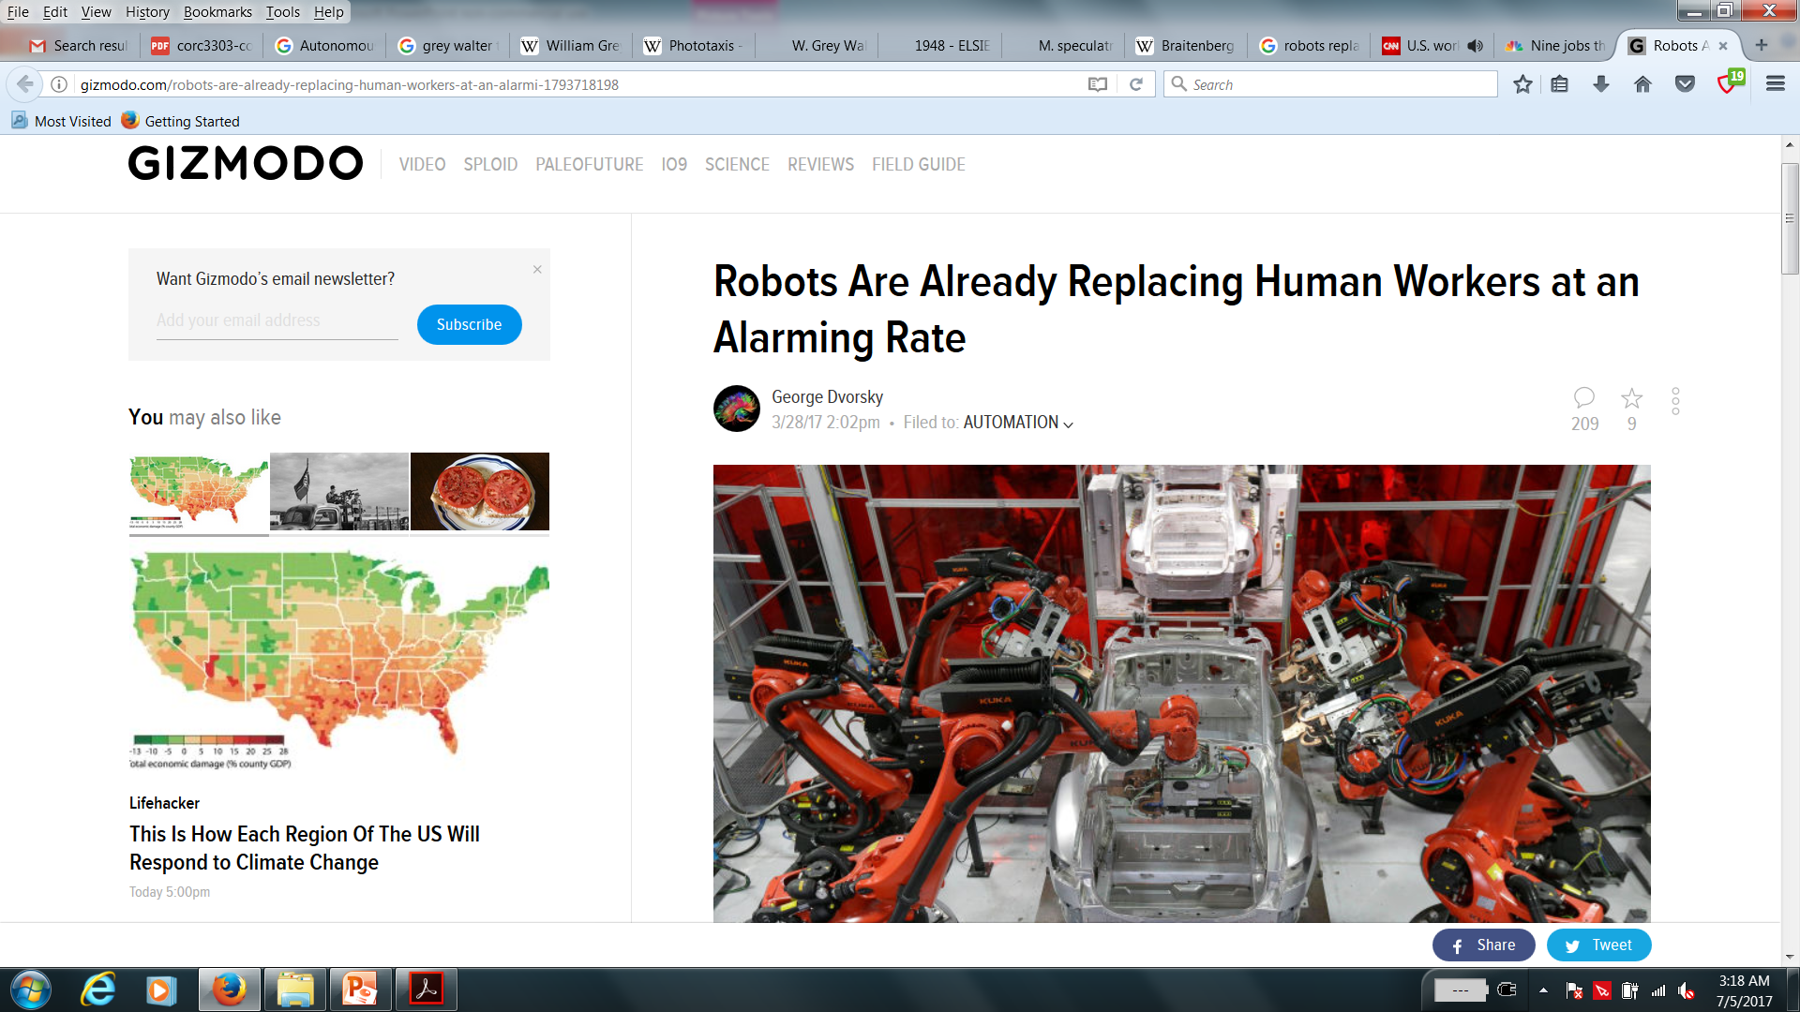
Future of Robotics

Slide 23
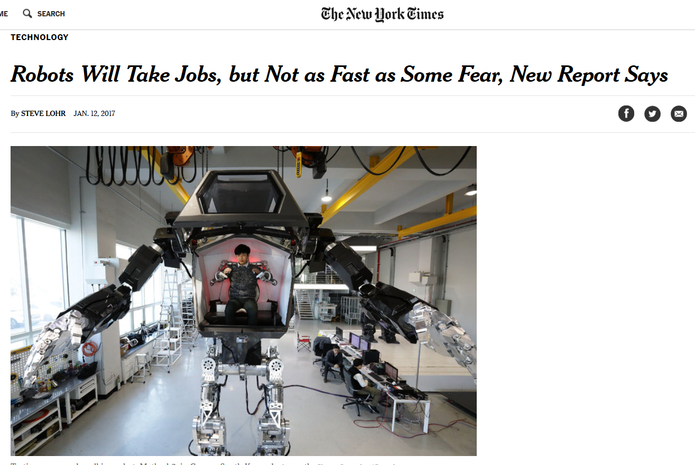
Future of Robotics (cont.)

Slide 24
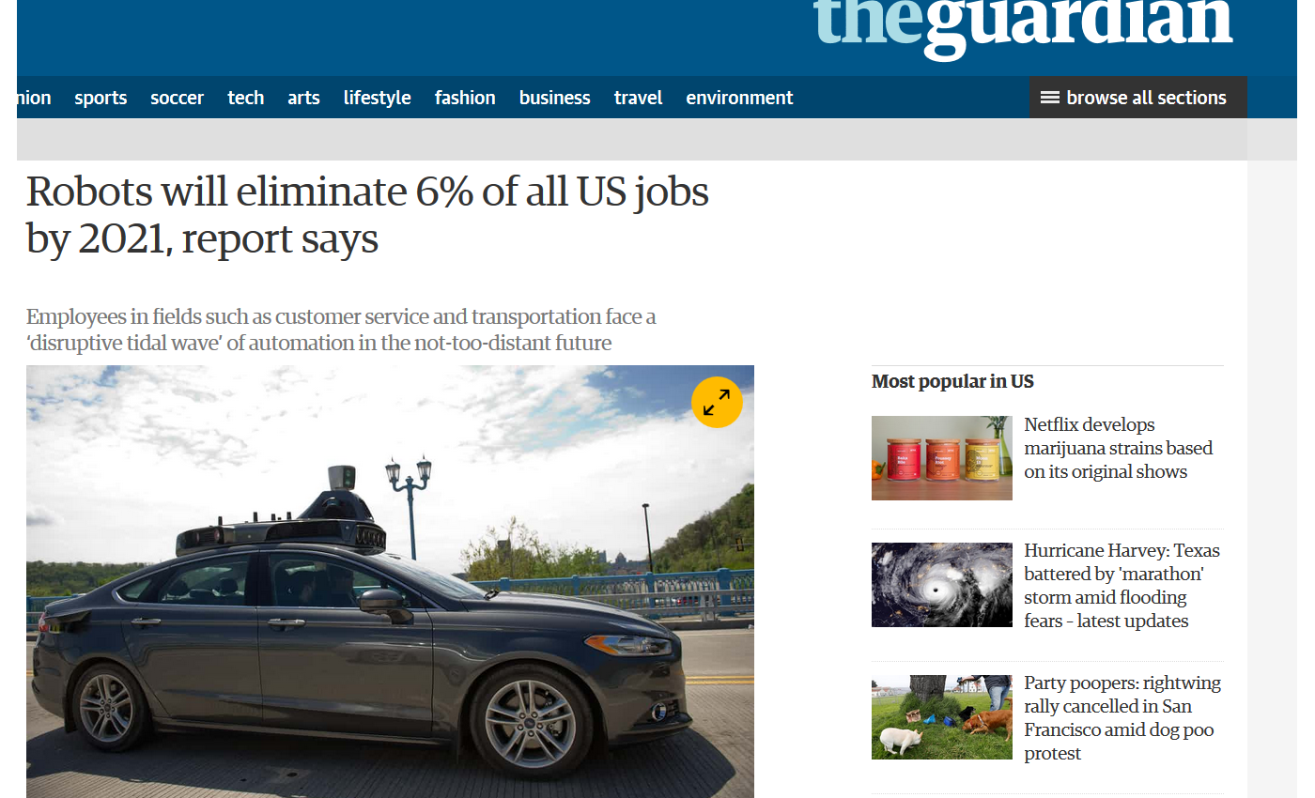
Future of Robotics (cont.)

Slide 25
Robot Components
Reminder:
For our purposes, a robot is an autonomous agent, acting independently. Our environment is the real world.
The robot can sense its environment (including its own internal state) and act on it to achieve pre-defined goals.

Slide 26
Robot Components
The robot needs to have:
A physical body – robots act in the physical world
Sensors
receive information from the outside world
A controller
Includes a computer for the needed computations
Notes:
Effectors include arms, legs, wheels, fingers, etc.
Actuators are mechanisms for activating process control through pneumatic, hydraulic or electric signals. Include motors pneumatic actuators (conversion of compressed air), hydraulic actuators which convert hydraulic pressure and flow into torque and rotation

Slide 27
Robot Components
The robot needs to have (cont.):
Actuators and effectors – devices that enable the robot to affect the environment
By exerting forces upon it or moving through it
Include artificial muscles and electric motors
Power Source – batteries, solar cells, etc. Multiple power sources can be used together
Notes:
Effectors include arms, legs, wheels, fingers, etc.
Actuators are mechanisms for activating process control through pneumatic, hydraulic or electric signals. Include motors pneumatic actuators (conversion of compressed air), hydraulic actuators which convert hydraulic pressure and flow into torque and rotation

Slide 28
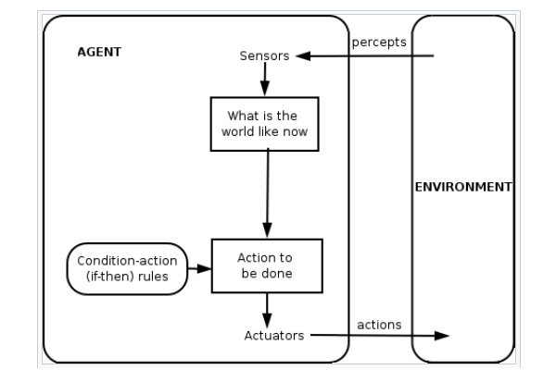
Robot Components (cont.)
*https://en.wikipedia.org/wiki/Intelligent_agent

Slide 29
LAB
Let’s start working with robots!

